Slide 1
From NDVI to N application map (Precision Agriculture)
Lecture notes preparation - about conceptual framework
(Education purpose)
Emir Memic
(University of Hohenheim)
April 2024

Slide 2
Outline
Satellite images download – Copernicus Browser
Copernicus Data Space Ecosystem (CDSE), Modified Copernicus Sentinel data 2024 processed in Copernicus Browser. https://browser.dataspace.copernicus.eu/
QGIS-based NDVI analysis and N prescription map processing
QGIS 2024. QGIS.org, Geographic Information System. QGIS Association. http://www.qgis.org
Discussion

Slide 3
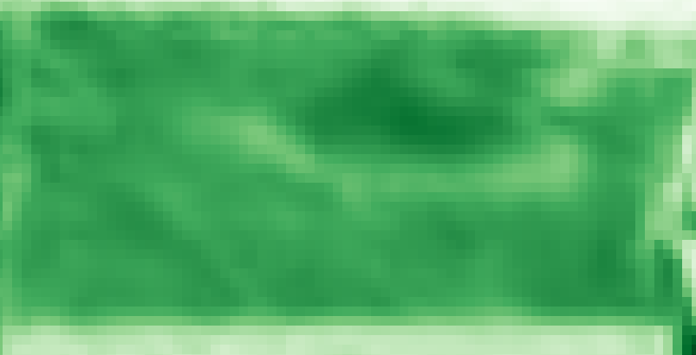
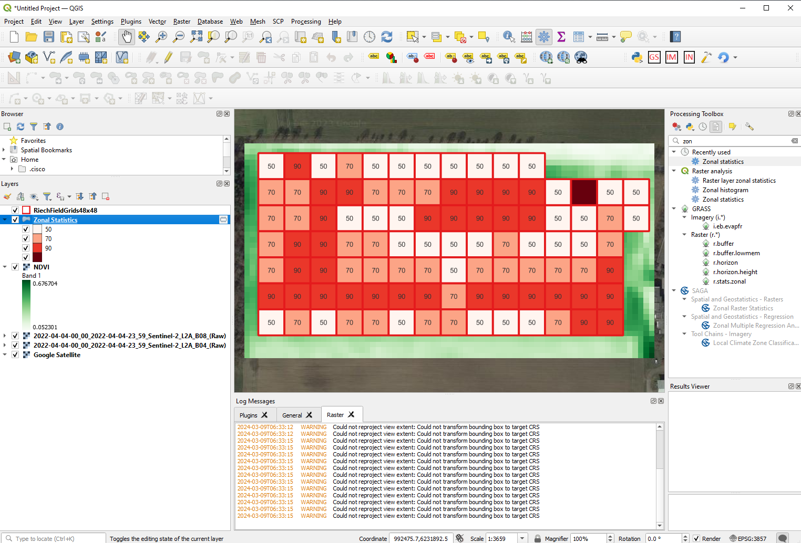
Objective:
From NDVI to N application map

Slide 4
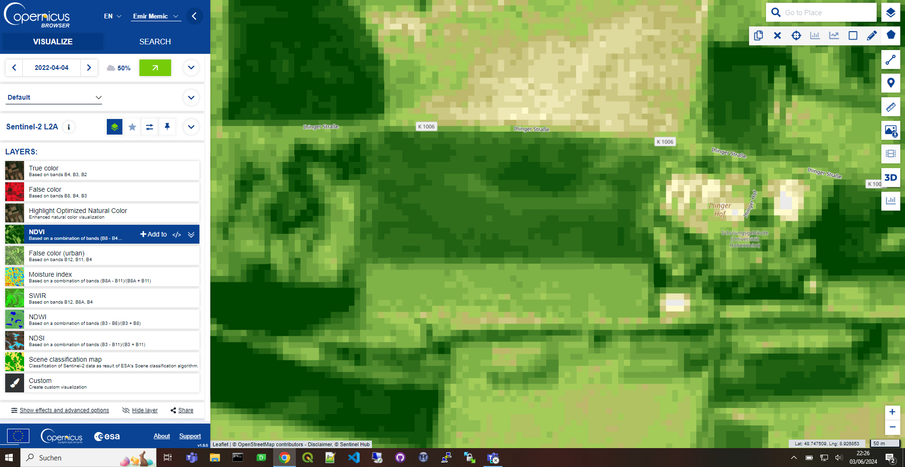
Acquiring satellite images via Copernicus Browser
Satellite images download – Copernicus Browser

Slide 5
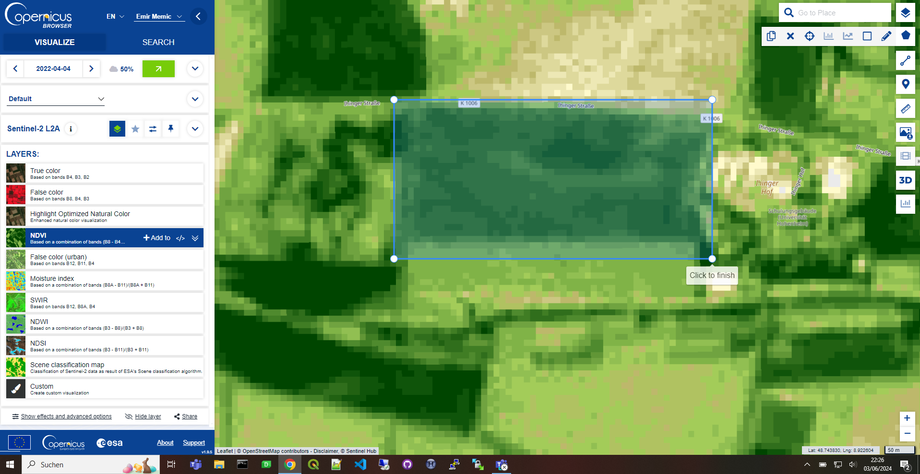
Delineating area of interest (polygon) for downloading
Satellite images download – Copernicus Browser

Slide 6
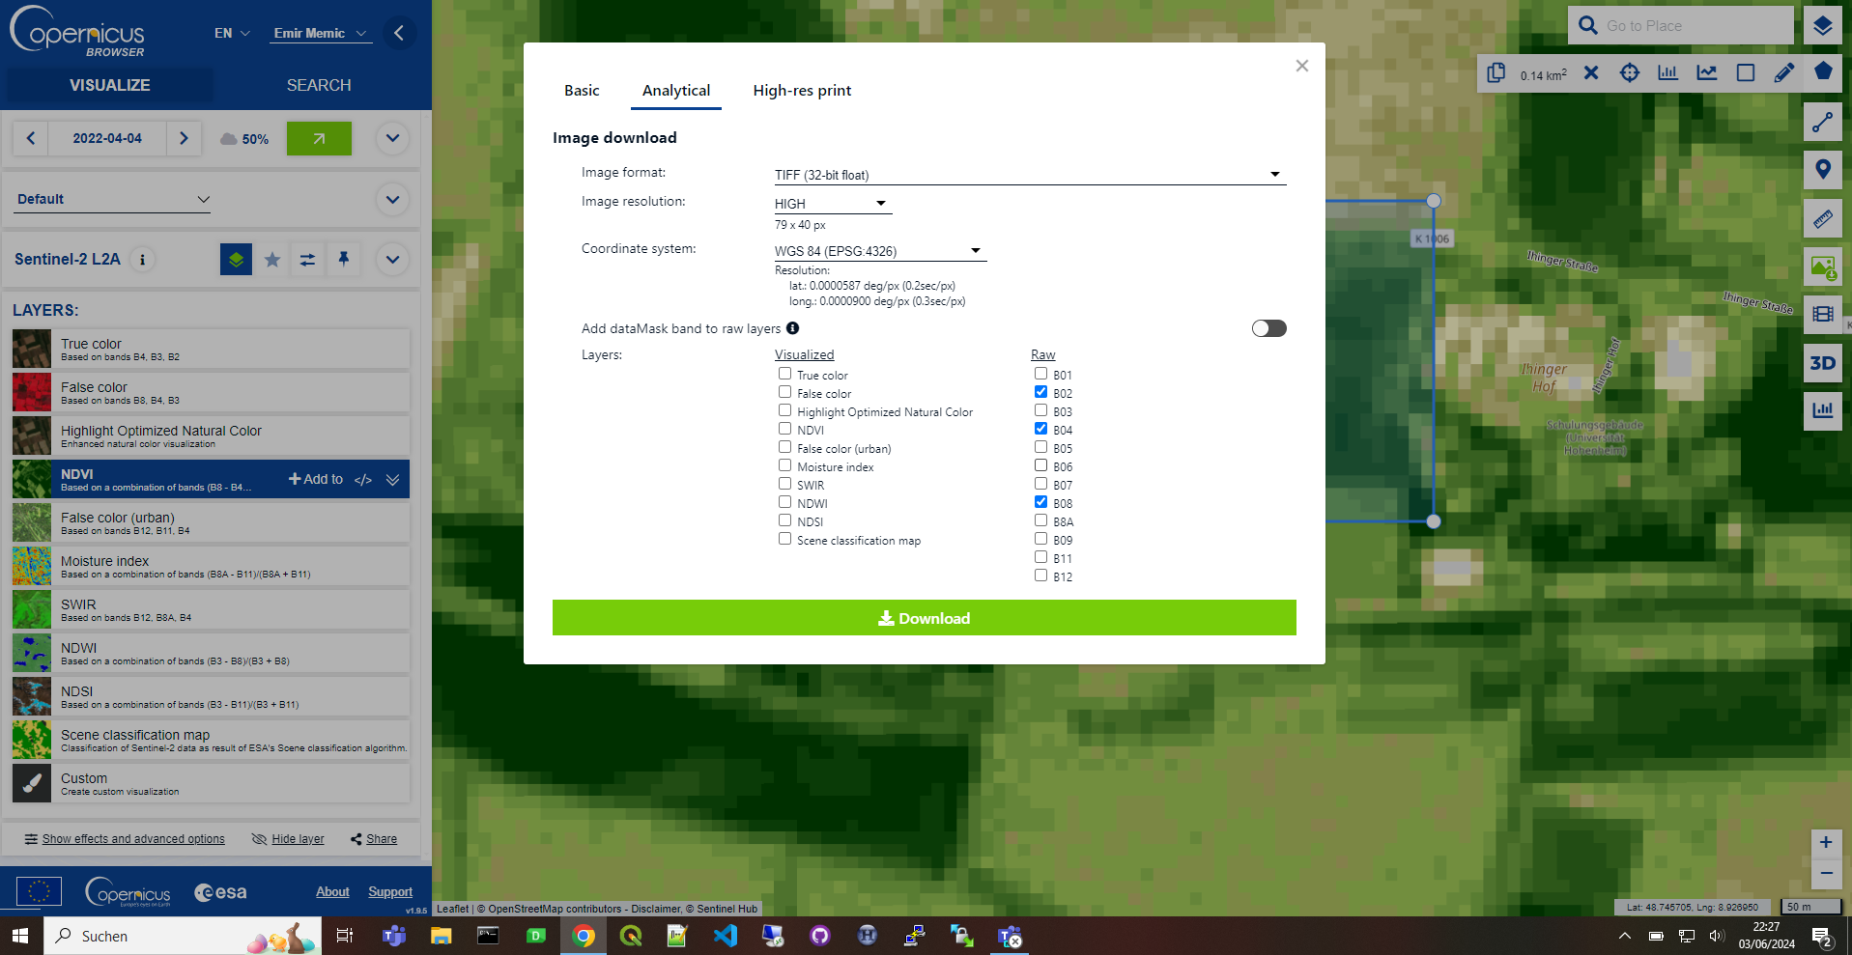
Downloading bands of interest – B02 (Blue), B04 (Red) and B08 (NIR)
Satellite images download – Copernicus Browser

Slide 7
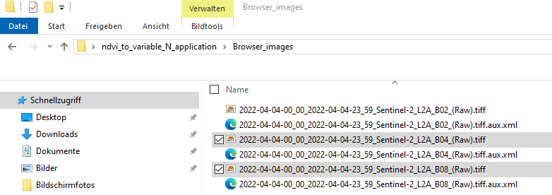
Downloaded and unzipped row data – for this example only B04 and B08 required for NDVI calculation
Satellite images download – Copernicus Browser

Slide 8
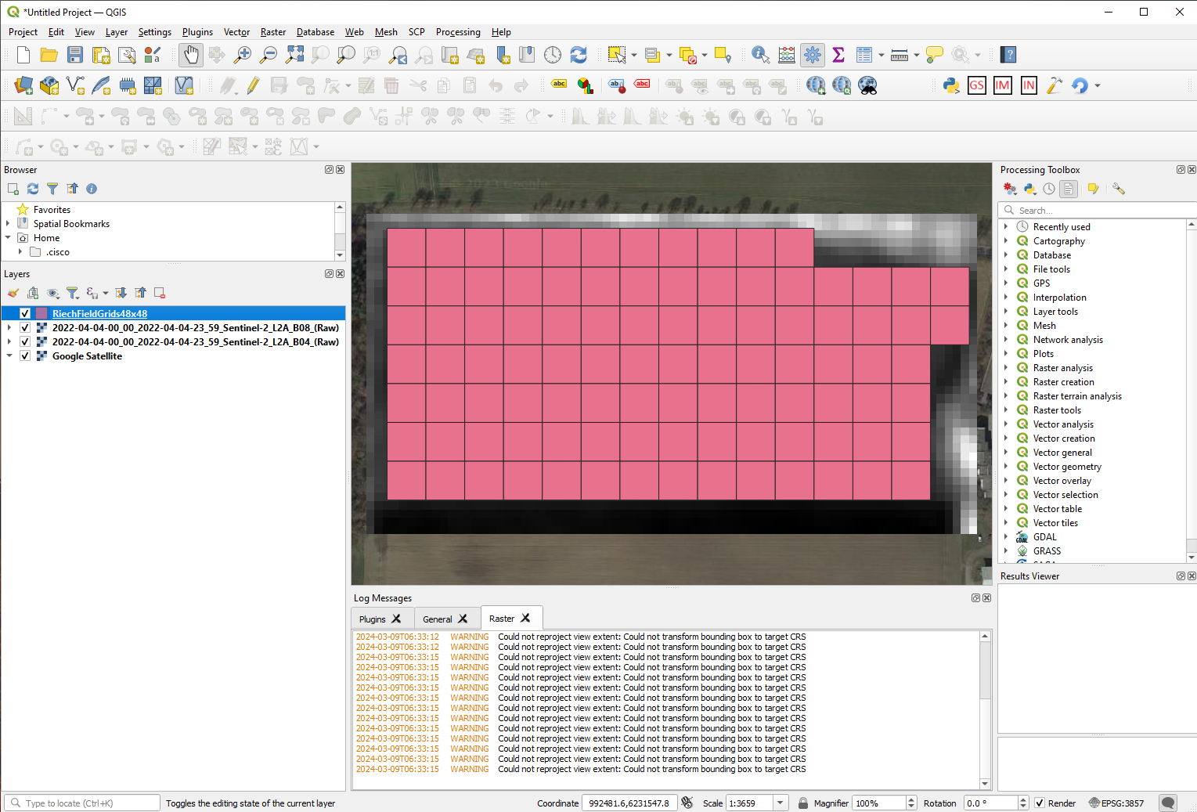
Uploading required data into QGIS (drag and drop): georeferenced images and raster grid of area of interest
QGIS-based NDVI analysis

Slide 9
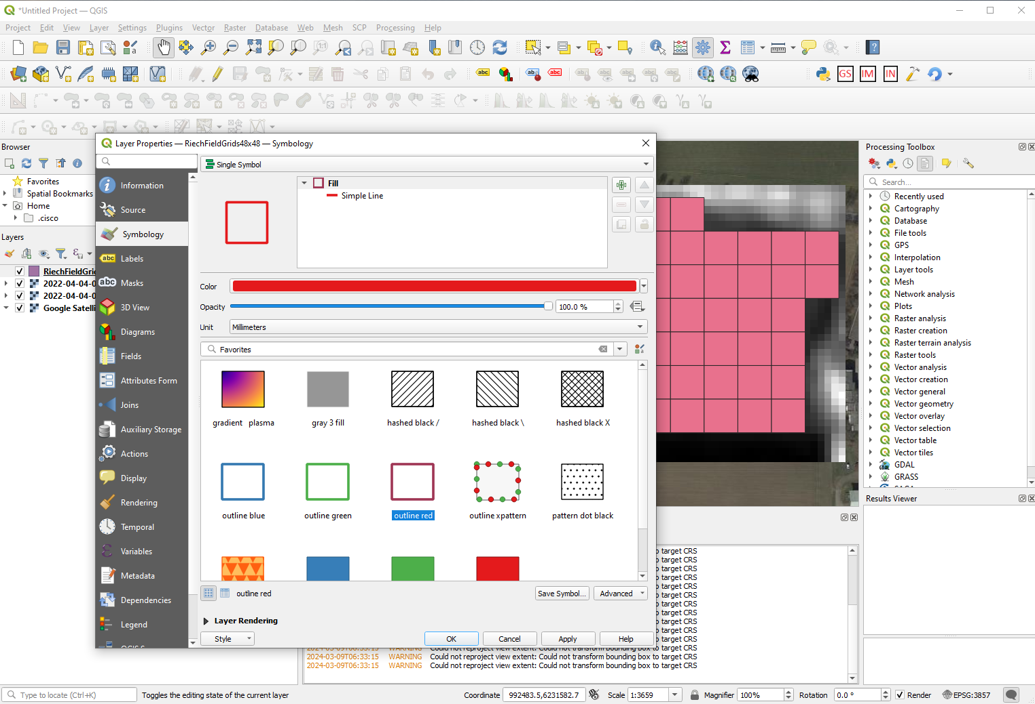
Modifying of the girds to get transparent background – Layer Properties -> Symbiology -> Single Symbol
QGIS-based NDVI analysis

Slide 10
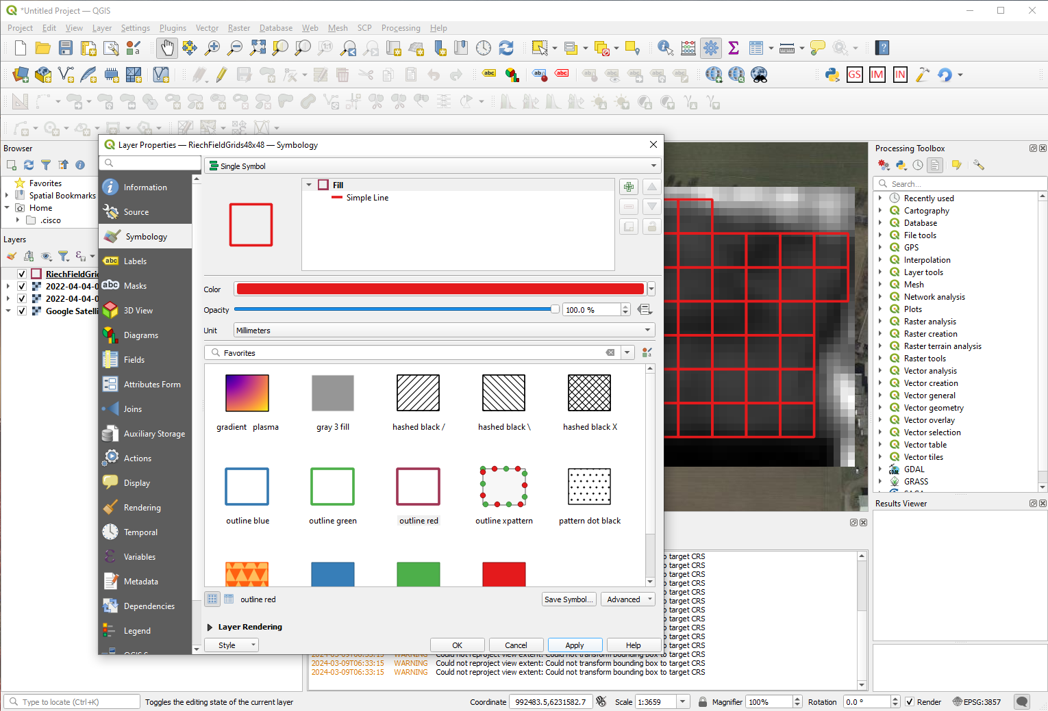
Modifying of the girds to get transparent background – when executed
QGIS-based NDVI analysis

Slide 11
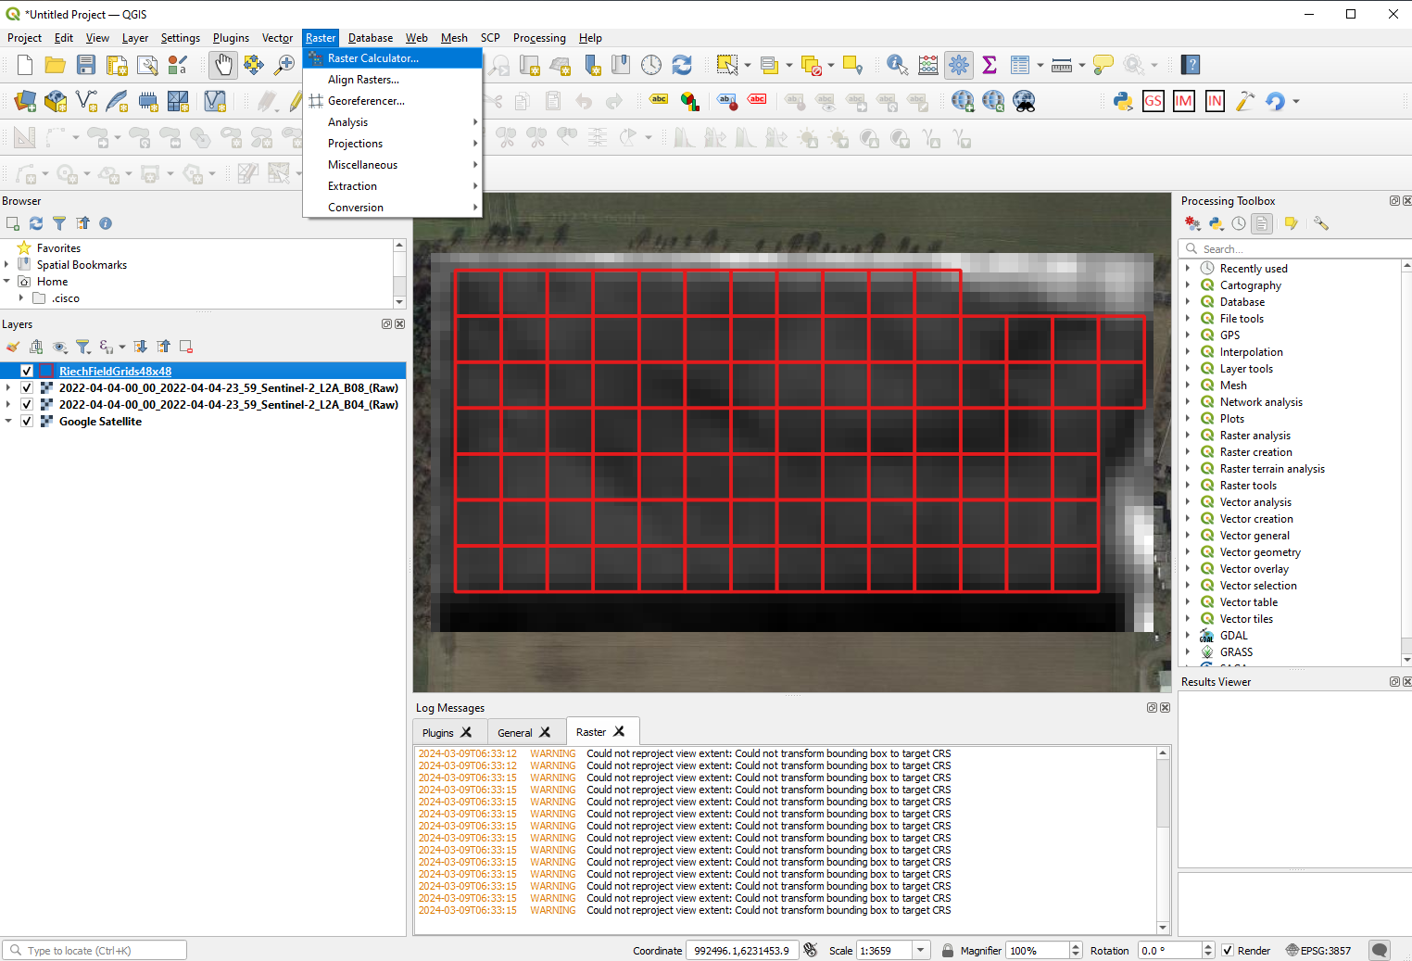
Calculating NDVI is conducted with Raster Calculator – Raster -> Raster Calculator
QGIS-based NDVI analysis

Slide 12
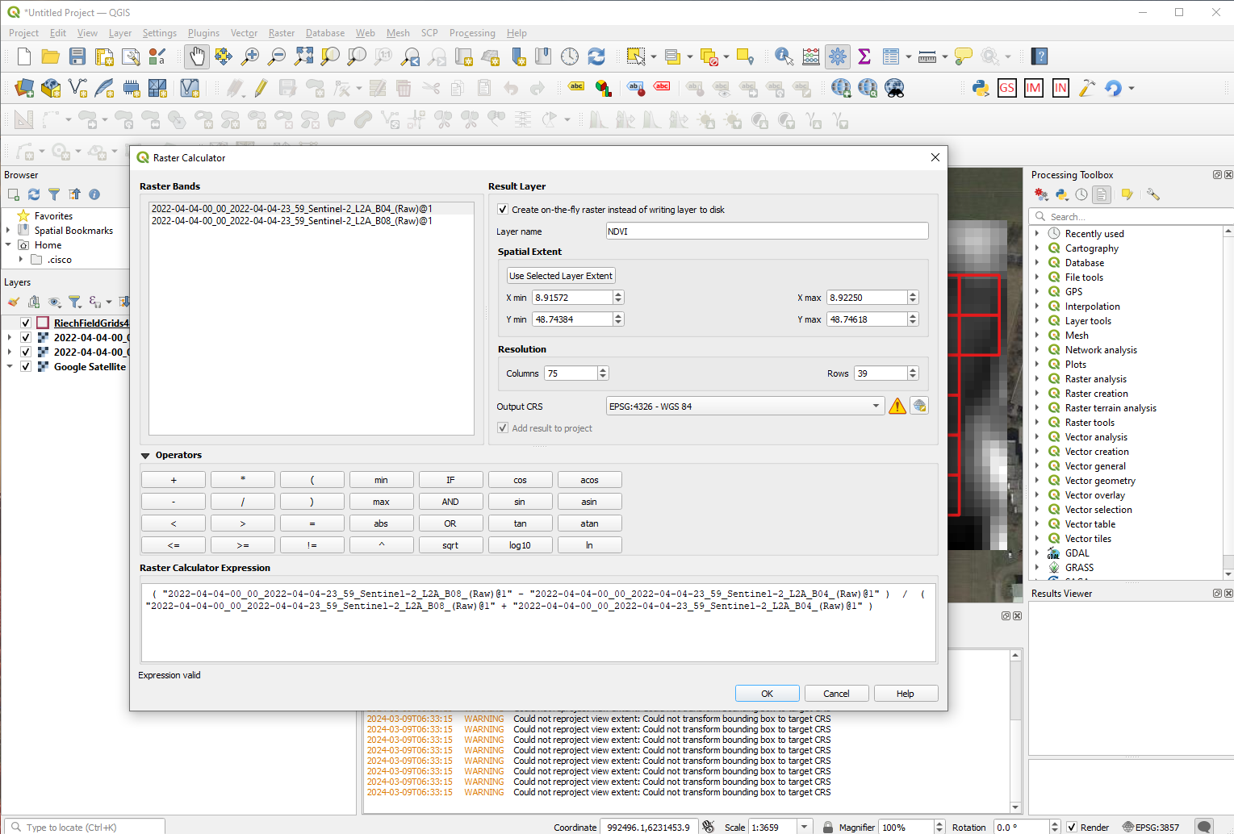
In Raster Calculator – minimum action required to calculate NDVI is indicated with red circles and arrows
NDVI=(NIR-RED)/(NIR+RED)
NDVI = (B08-B04)/(B08+B04)
QGIS-based NDVI analysis

Slide 13
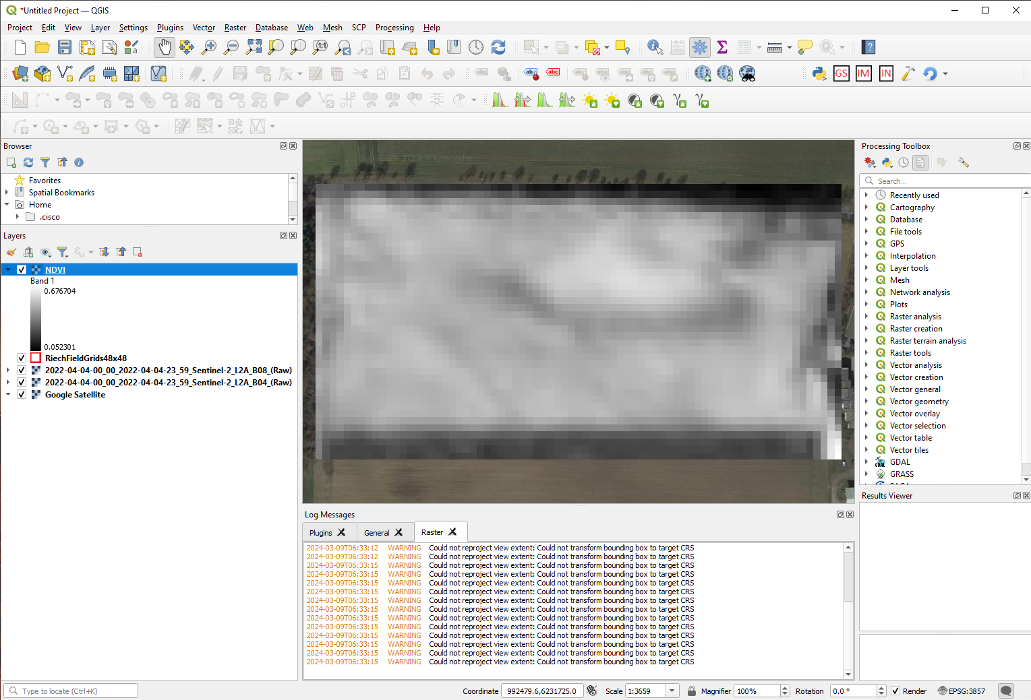
After Raster Calculator calculations are conducted a user gets NDVI layer in QGIS
QGIS-based NDVI analysis

Slide 14
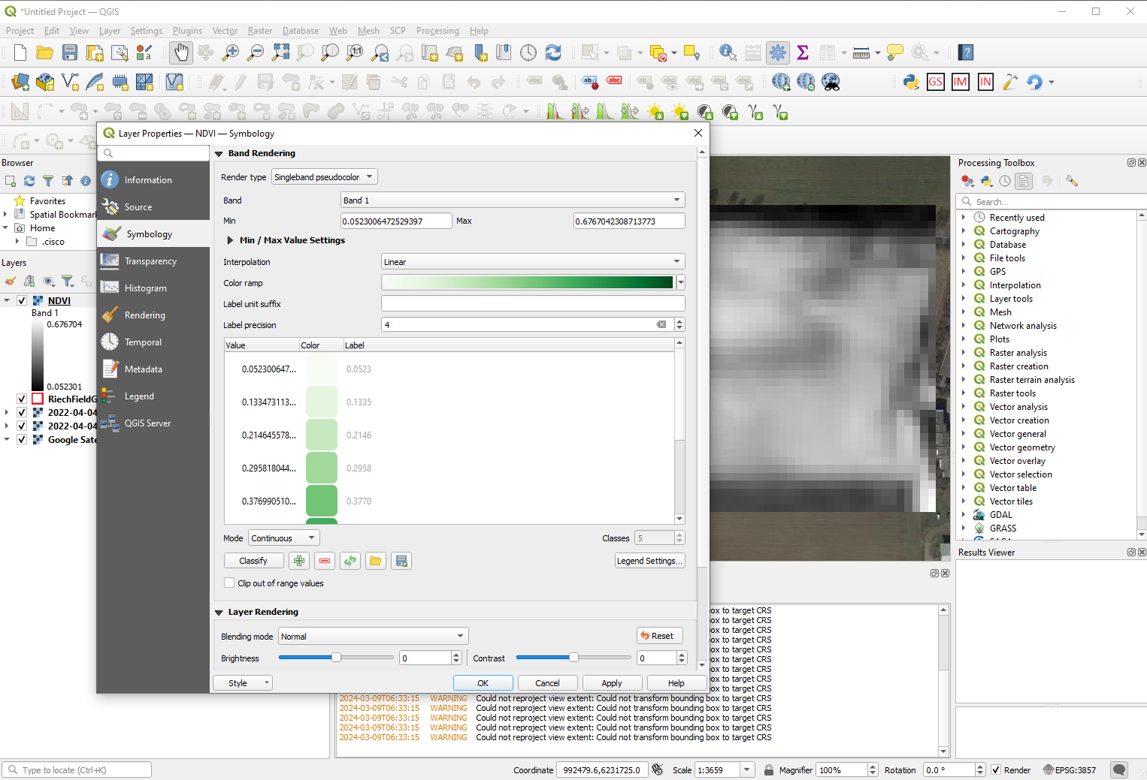
NDVI layer (in gray by default) can be changed to green – Layer Properties -> Symbiology -> Singleband Pseudocolor
QGIS-based NDVI analysis

Slide 15
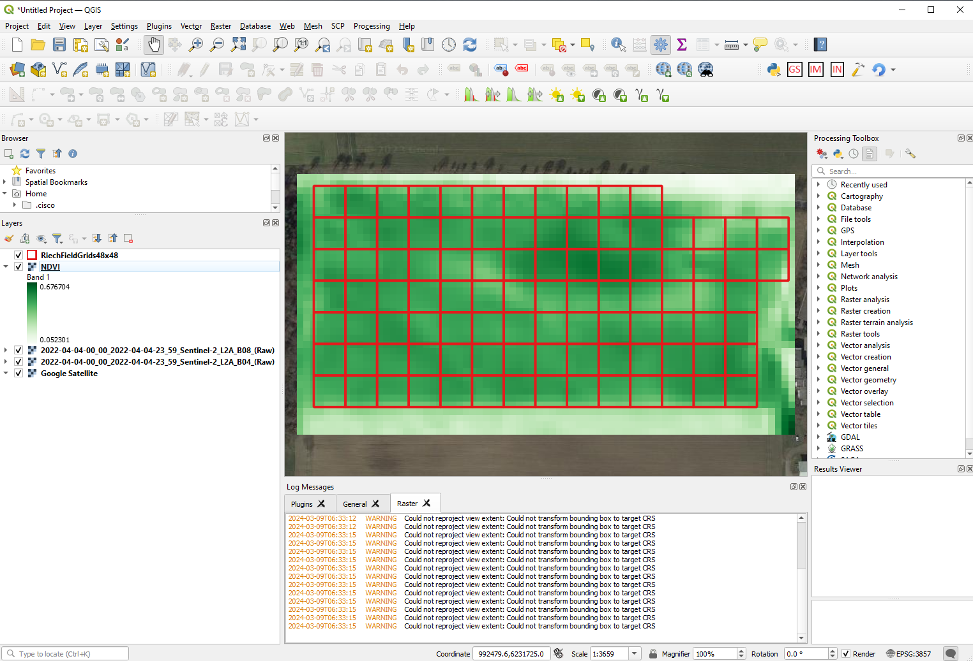
NDVI layer in green
QGIS-based NDVI analysis

Slide 16
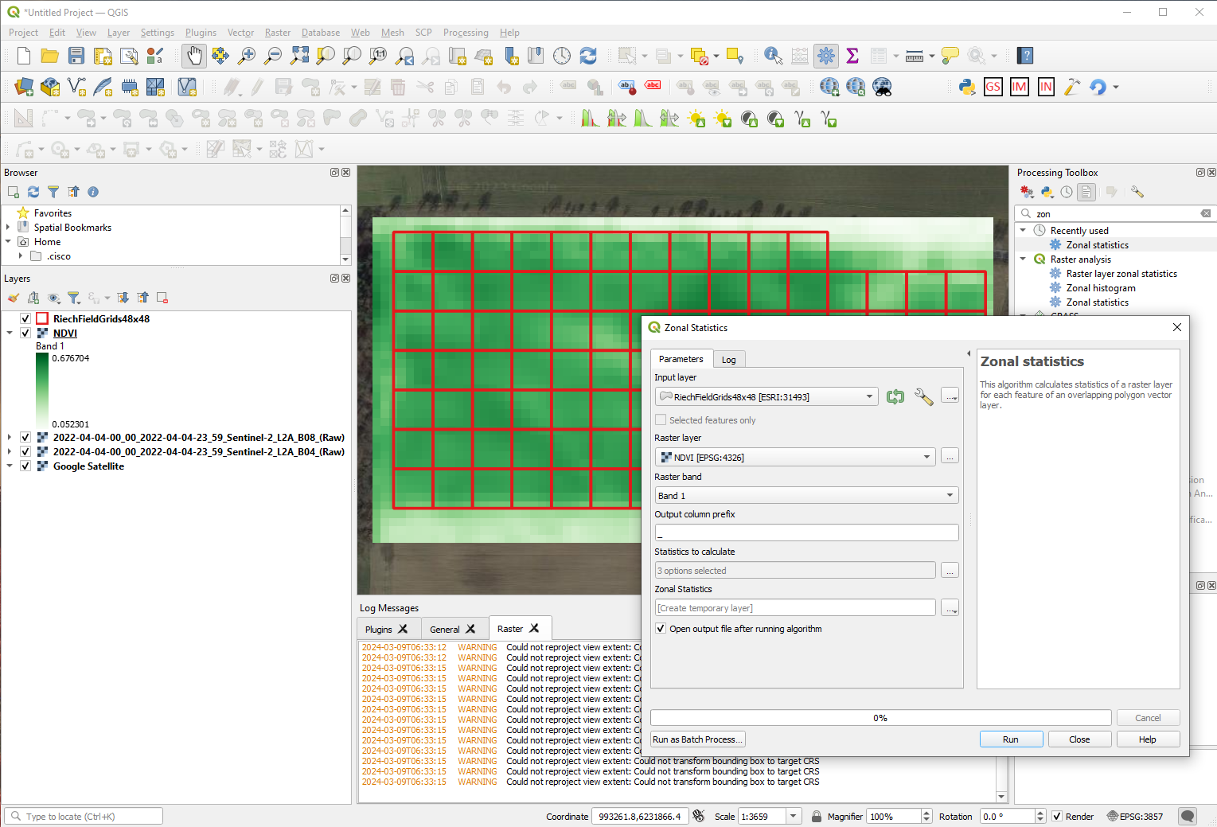
Calculating NDVI for each grid – based on Grid layer and NDVI layer with Zonal Statistics
QGIS-based NDVI analysis

Slide 17
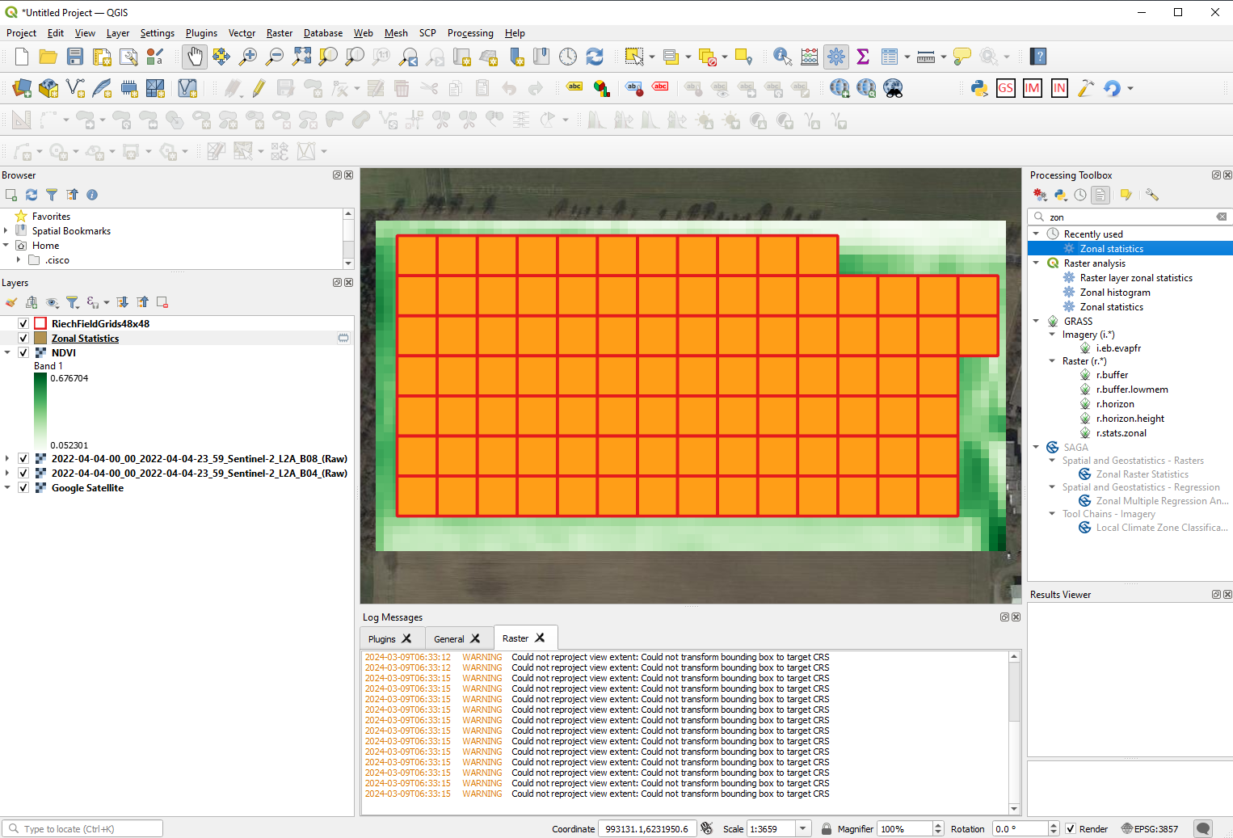
Zonal Statistics after execution produce Zonal Statistics (temporary layer)
QGIS-based NDVI analysis

Slide 18
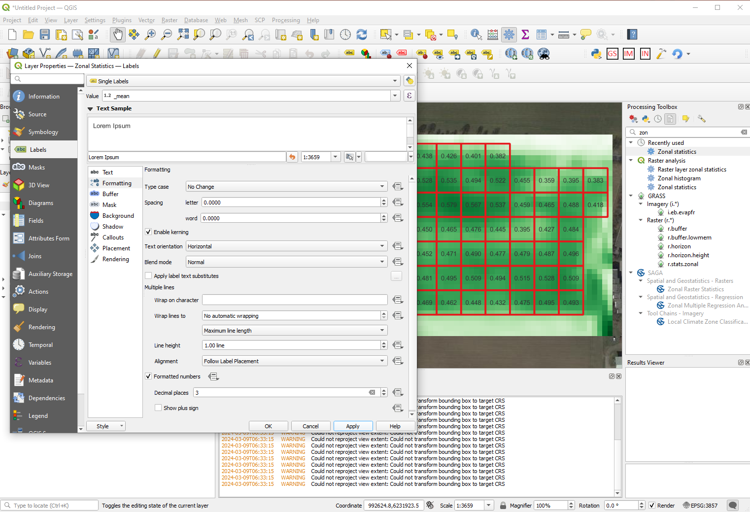
Zonal Statistics layer – to show NDVI for each grid – Layer Properties -> Labels -> Single Labels -> _mean (value select)
QGIS-based NDVI analysis

Slide 19
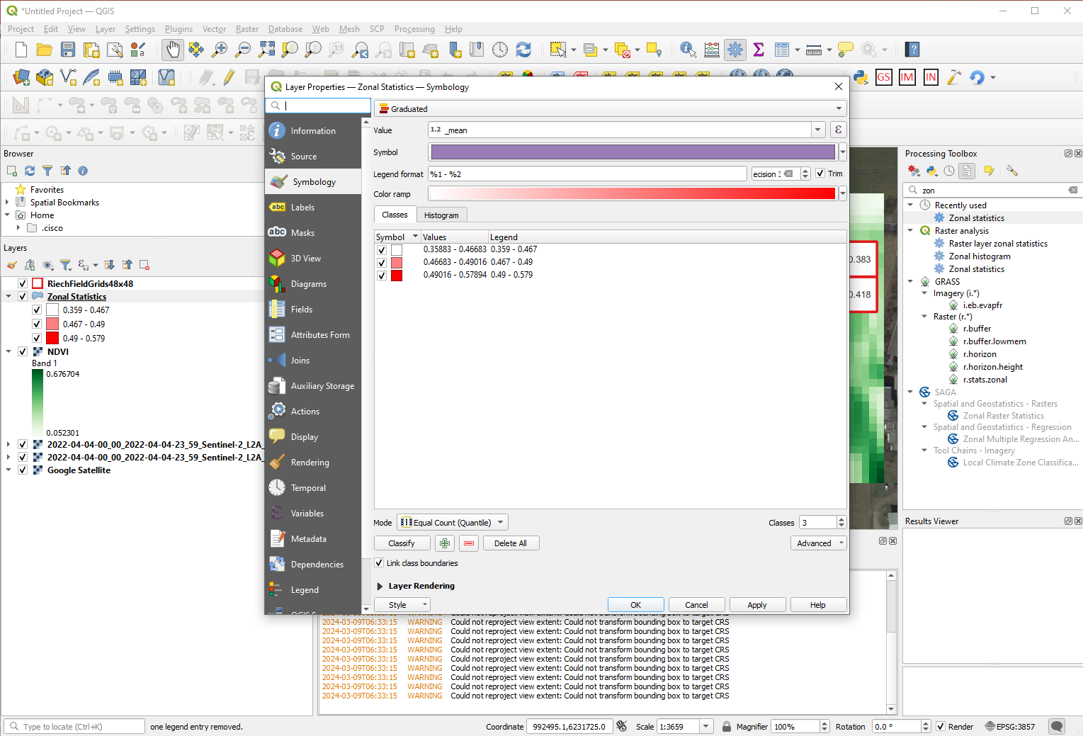
Zonal Statistics layer – create 3 NDVI categories – Symbiology -> Graduated -> _mean -> Classes (3) -> Classify
QGIS-based NDVI analysis

Slide 20
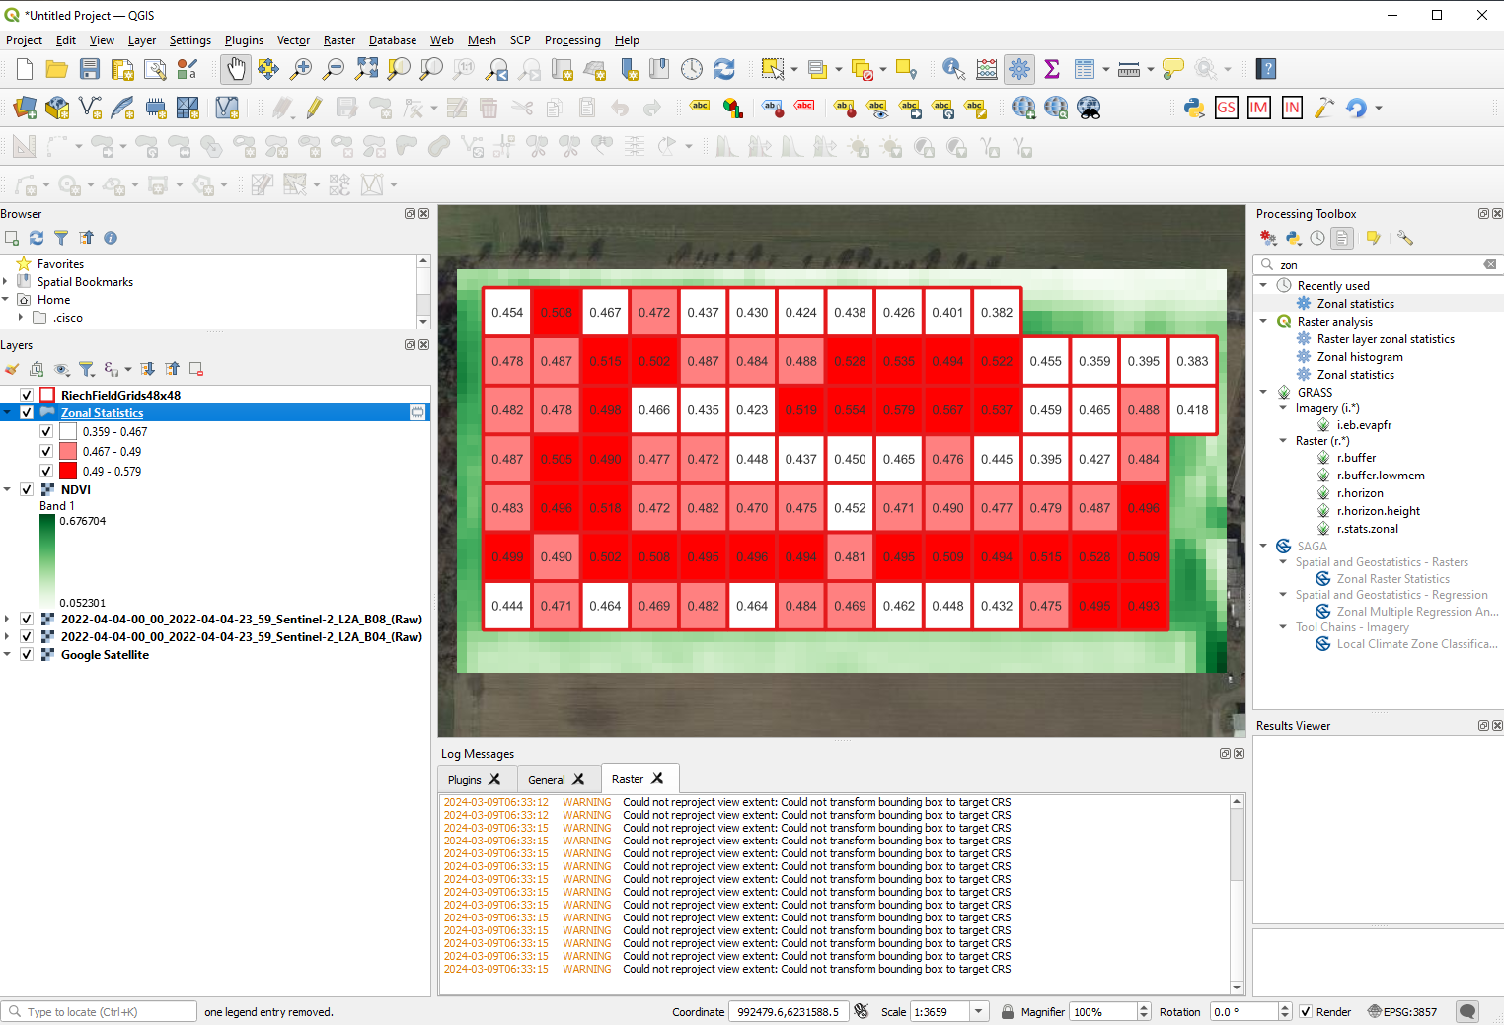
Zonal Statistics layer – setup of previous slide when executed will produce heat map of index variability (3 categories)
This example was oversimplified with 3 NDVI categories (low, medium, high) for later 3 N-application amounts (low, medium, high) – for educational purpose
QGIS-based NDVI analysis

Slide 21
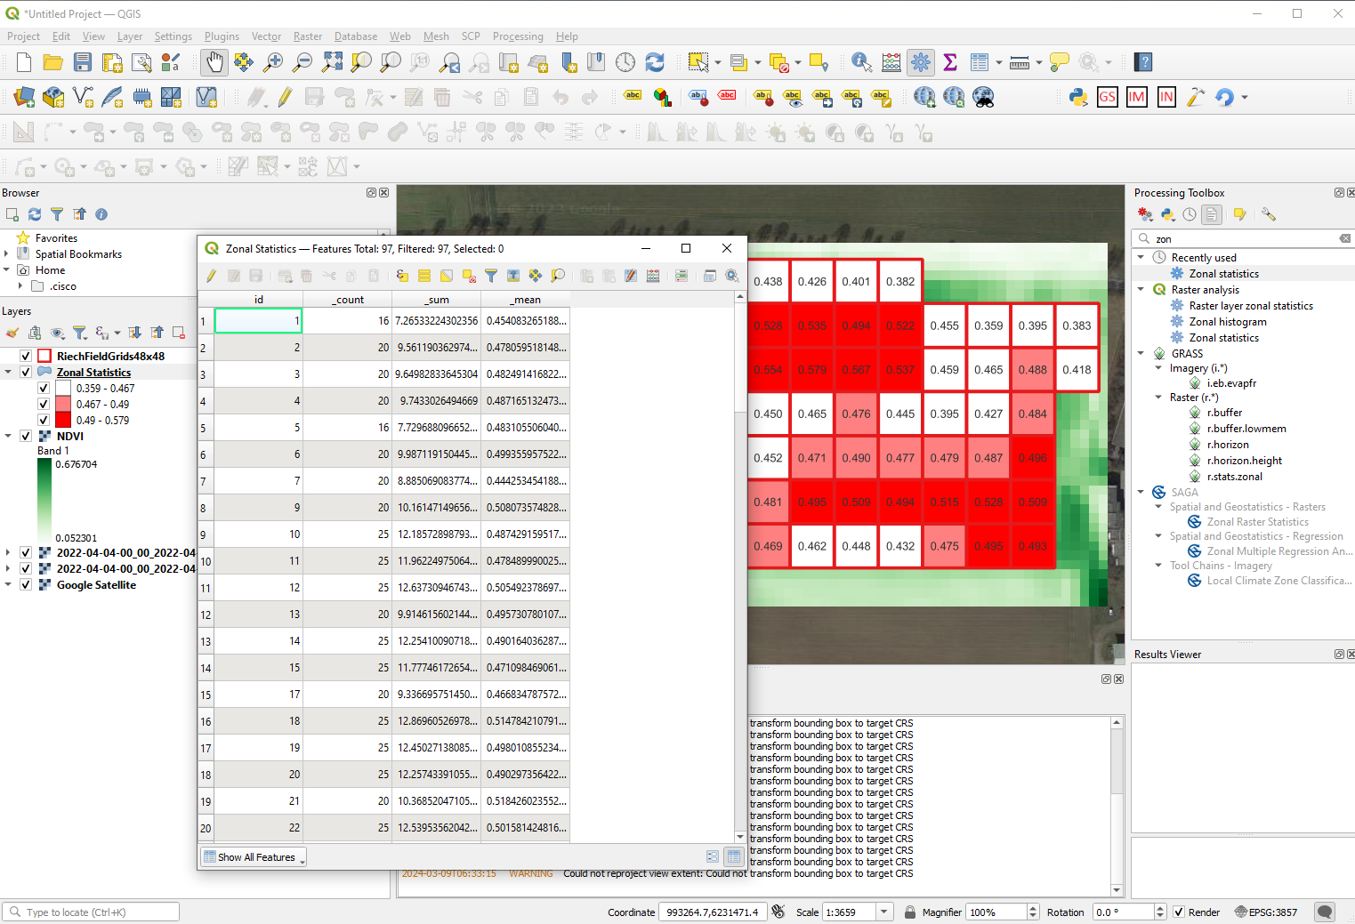
Zonal Statistics layer – Properties -> Open Attribute Table (shows statistics for each grid, including number of pixels per grid – count)
N prescription map processing

Slide 22
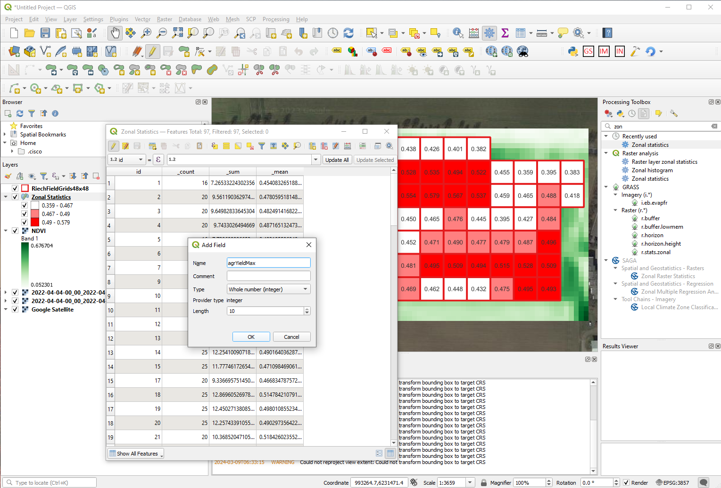
Zonal Statistics layer –Attribute Table tool -> Add Field (will create a place holder to populate later with corresponding N application kg)
N prescription map processing

Slide 23
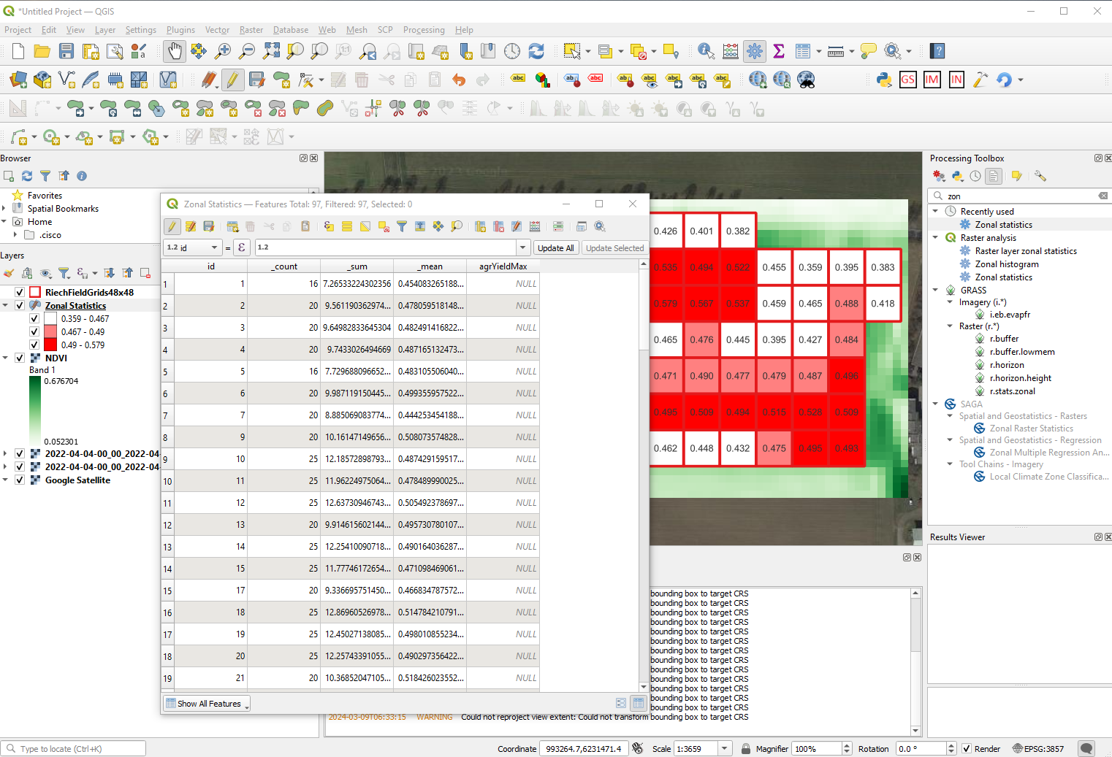
Zonal Statistics layer –Attribute Table – new field added: agrYieldMax
N prescription map processing

Slide 24
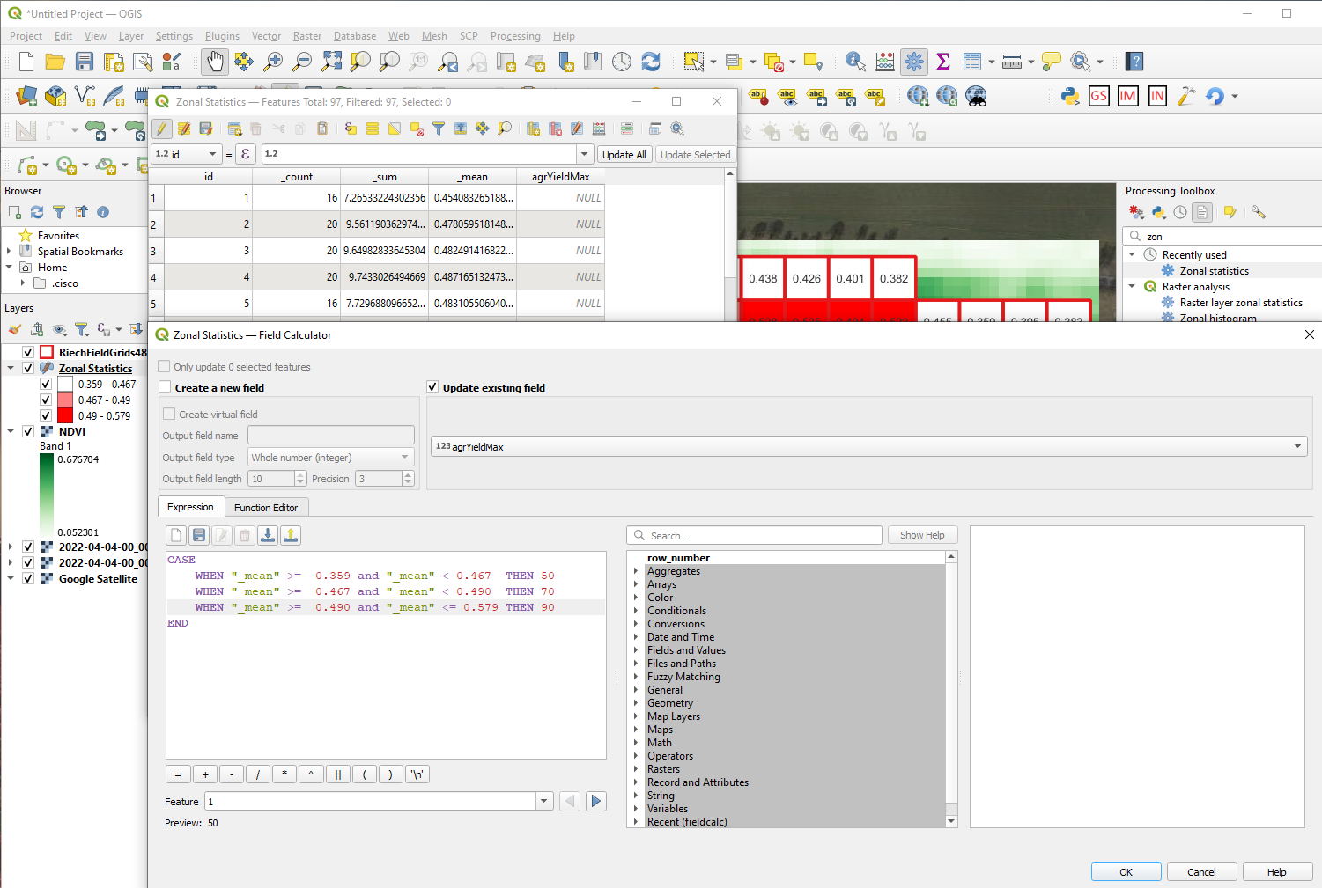
Zonal Statistics layer –Attribute Table – Field Calculator setup – based on the grid NDVI value the grid is allocated N application value (kg)
This code when added into Field Calculator consol to allocate N kg value: If NDVI is bigger or equal to 0.359 and less then 0.467 in the field in Attribute Table agriYieldMax 50 value is added. 50 -> low N application rate etc.
CASE
WHEN "_mean" >= 0.359 and "_mean" < 0.467 THEN 50
WHEN "_mean" >= 0.467 and "_mean" < 0.490 THEN 70
WHEN "_mean" >= 0.490 and "_mean" <= 0.579 THEN 90
END
N prescription map processing

Slide 25
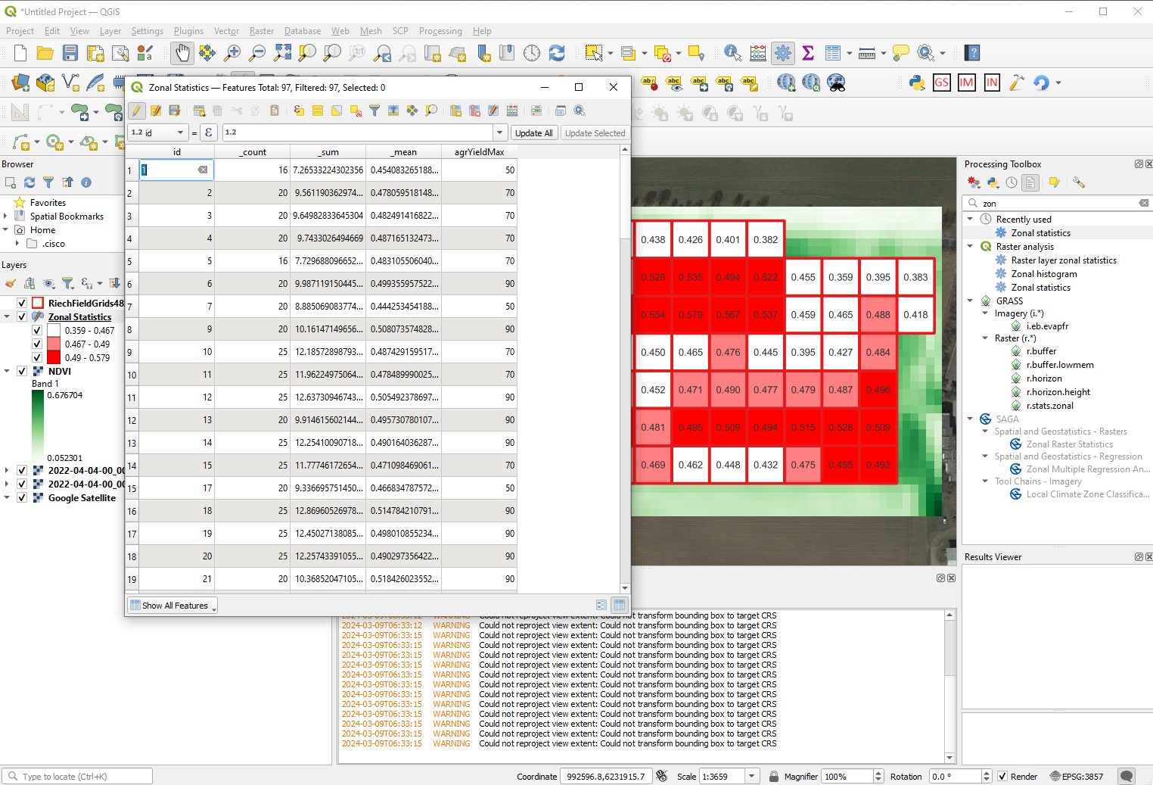
Zonal Statistics layer – based on grid NDVI values and categories the N-application values are allocated
N prescription map processing

Slide 26
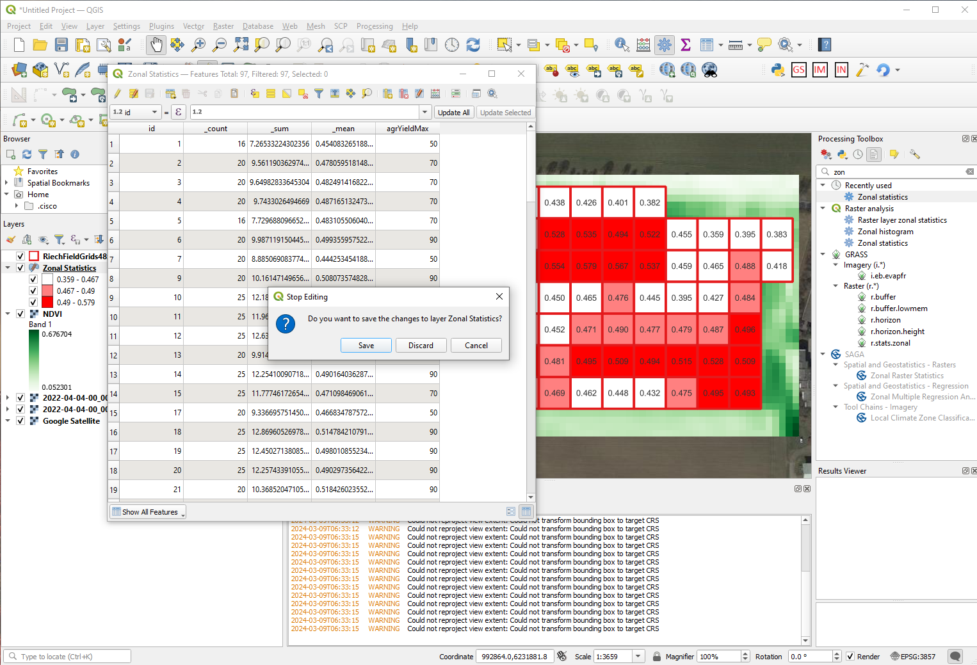
Zonal Statistics layer – based on grid NDVI values and categories the N-application values are allocated – stop editing and save!
N prescription map processing

Slide 27
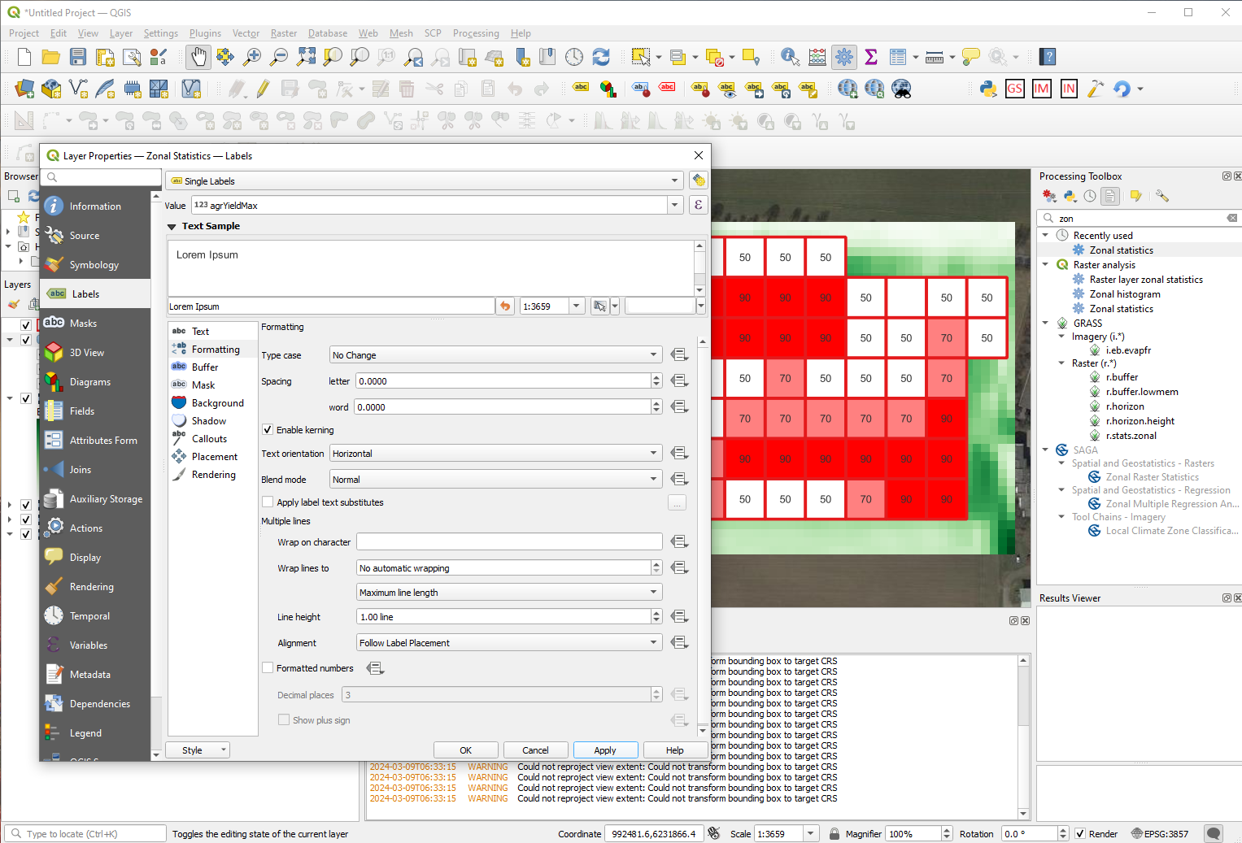
Zonal Statistics layer – Labels -> Single Labels -> agrYieldMax (value) - > will N application values to each corresponding grid
N prescription map processing

Slide 28
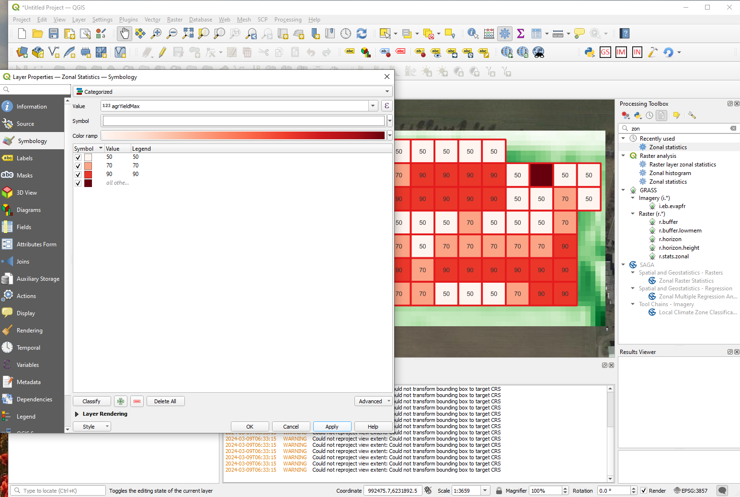
Zonal Statistics layer – Symbiology -> Categorized -> agrYieldMax -> Classify
N prescription map processing

Slide 29
Zonal Statistics layer – N application mat generated!
None defined catogory was result of non detailed setup of NDVI categories.
These ranges have to be defined carefully!
N prescription map processing

Slide 30
Discussion

